Slide 1
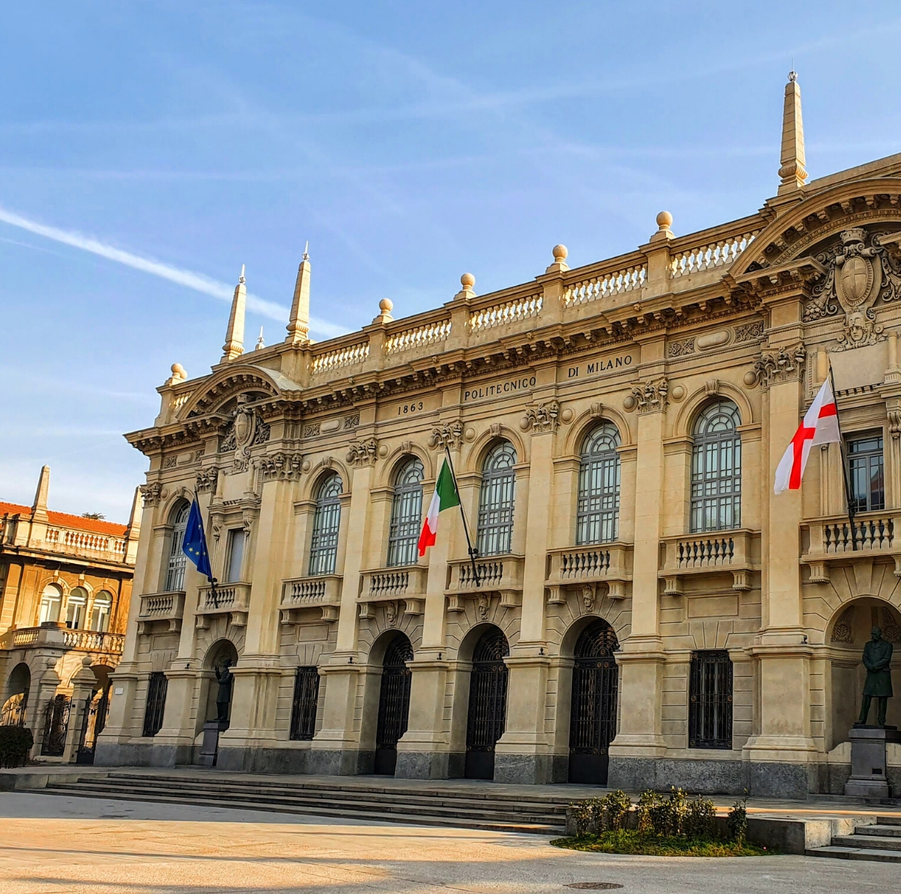
OPEN DAY
March 7th
STUDY ARCHITECTURE & DESIGN
IN ITALY

Slide 2
ON THE AGENDA
Why study in Italy?
Procedures to enroll in an Italian university
Requirements
Documents
Timelines
Architecture & Design programs & admission tests
Our preparation courses
Structure
Contents
How to enroll in our courses
Q&A section

Slide 3
Why study in Italy and in Milan?
Quality of teaching
Affordability &
low living cost
Work opportunities
Culture & safety
Highly stimulating city
Most Italian Universities rank in the top 200 and top 100 Universities in the world.
Milan Politecnico ranks, respectively, #10 and #8 in the QS World Ranking for Architecture and Design.
Great historical heritage, food, atmosphere and welcoming people. 30th safest country in the world.
Tuition fees and living in Italy is significantly cheaper than living in the US, UK and many other European countries.
Plenty of opportunities for international students. Up to 20 hours per week.
12-month post study work right.
Milan is one of the richest cities in terms of architecture: centuries-old buildings stand right next to ultra-modern skyscrapers.

Slide 4
Requirements to enroll in an Italian University
Requirements and procedures to enroll in an Italian University vary depending on whether you are an EU or a non-EU student, and whether you’re applying at undergraduate (referred to as ‘first cycle’) or graduate level (second and third cycle).
Each University has a different admission procedure and its own admission test – details about the enrollment procedures can be found on the website of each University and on the portal https://www.universitaly.it/index.php/
General requirements
Have 12 years of global schooling or 10/11 years + complimentary studies, which can be:
Pass the entry exam at the chosen University
Pass the language exam (Italian or English) organized by the University (if required)
one (in case of 11 years) or two (in case of 10 years) years of University studies;
a post-secondary title;
a foundation year: a preparatory program at an Italian or foreign institution.

Slide 5
Documents needed for enrollment
STANDARD DOCUMENTS
Legally translated High school diploma
Declaration of value (Dichiarazione di Valore) – a document issued by Italian embassies and consulates in the country of residence listing the candidate’s completed studies
Certificate proving the completion of 1 or 2 years of academic studies for those countries where the educational system lasts only 11 or 10 years
EXTRA DOCUMENTS (non-EU students)
Pre-registration (via the Italian diplomatic-consular representation in the country of residence)
The entry VISA
Certificate attesting that the University entrance examination in the country of origin has been passed if required by law (e.g. Gao Kao for Chinese students, Suneung for South Korean students, and Vestibular for Brazilian students.)

Slide 6
General timeline - Architecture
APRIL – JUNE: Pre-enrollment at the Italian embassy/consulate in country of origin*
Documents needed: High School Diploma
JUNE – MID JULY: Register online for the ARCHED test
Documents needed: Declaration of Value; legalized and apostilled translation of High School Diploma
END OF JULY: Sit the ARCHED test (onsite)
AUGUST – SEPTEMBER: Visa application*
Documents needed: Confirmation letter of application to the exam; International Health Insurance; Declaration of Financial capacity
SEPTEMBER – OCTOBER: Enrollment
Documents needed: Passing the admission test, Student visa + Permit of stay, Payment of the tuition fee for the first year
*Only NON-EU students

Slide 7
General timeline - Design
EU STUDENTS | NON-EU STUDENTS
APRIL 10th – Register for the TOLD test APRIL 13th – MAY 23rd Sit the TOLD test (onsite) SEPTEMBER - OCTOBER: Enrollment Documents needed: Passing the admission test, Student visa + Permit of stay, Payment of the tuition fee for the first year | APRIL – JUNE: Pre-enrollment at the Italian embassy/consulate in country of origin MAY 31st: Register online for the TOLD test (deadline) Documents needed: Declaration of Value; legalized and apostilled translation of High School Diploma JULY-AUGUST: Visa application (visto di studio per immatricolazione) Documents needed: Confirmation letter of application to the exam; International Health Insurance; Declaration of Financial capacity SEPTEMBER 3rd: Sit the TOLD test (onsite) OCTOBER: Enrollment Documents needed: Passing the admission test, Student visa + Permit of stay, Payment of the tuition fee for the first year

Slide 8
Where to study Architecture and Design in Italy
ARCHITECTURE
Milan Politecnico
Turin Politecnico
University of Florence
University of La Sapienza - Rome
University of Venice-IUAV
University of Ferrara
University of Pavia
University of Padua
University of Genoa
University of Bologna
DESIGN
Milan Politecnico / POLI.Design
Florence Design Academy
Polimoda (Florence)
University of La Sapienza - Rome
Domus Academy (Milan)
Marangoni Institute (Milan)
IUAD – Institute of Universal Art and Design (Naples and Milan)
IED – European Institute of Design (Milan)
University of Bologna

Slide 9
Admission tests at Milan Politecnico
 | Architecture – ARCHED | Design - TOLD
Date | July 26° (2023) | EU: April 13° - May 23° 2024 Non-EU: September 3° 2024
Available spots | 795 total (2023 data) (745 Italian curriculum, 50 English curriculum) | 890 total (2023 data) among 4 different branches
Structure | 50 questions in 100 minutes Verbal comprehension (10) General knowledge (10) Logic (10) Drawing and Representation (10) Maths & Physics (10) | 90 questions in 85 minutes General knowledge (24) Geometry and Representation (12) History of art and design (12) Logic (6) Verbal comprehension (6) English language skills (30)
Points | Correct answer = 1 point Wrong answer = -0,25 points No answer = 0 points

Slide 10
General course contents & structure
Extensive or intensive format
Online or on-site format
Good knowledge of English required for the English curricula, and of Italian for the Italian curricula
Min. 5 participants or reduction in number of lessons delivered
2 main sections
Subject-specific topics
History of art and Architecture, Representation, Maths, Physics, etc.
Theory and practice.
Logical reasoning
Problem solving, promote or defend a particular point of view, arguments.

Slide 11
Our Preparation courses: Architecture
 | EXTENSIVE PREP. COURSE | INTENSIVE PREP. COURSE
Duration | 10 weeks | 4 weeks
 | April 15th – June 21st | June 24th – July 19th
Schedule | Around 2 to 3 hours per day, generally in the early afternoon (Italian time) | Monday to Friday all day long (with breaks in-between). Sometimes on Saturday
Format & language | Online, English | Onsite, English or Italian
Number of lessons | 140 lessons (45 minutes each)
Topics | General culture, Logic, History of art and Architecture, Representation, Maths and Physics
Language & Price | € 1.870 + € 30 registration fee | English: € 1.870 + € 70 registration fee Italian: € 1.570 + € 70 registration fee

Slide 12
Our Preparation courses: Design
 | INTENSIVE PREPARATION COURSE
Duration | 4 weeks
 | June 24th – July 19th
Schedule | Monday to Friday all day long (with breaks in-between). Sometimes on Saturday
Number of lessons | 140 lessons (45 minutes each)
Topics | General knowledge, Logic, Verbal comprehension, Geometry and Representation, History of art and design
Language | Italian
Price | € 1.570 + € 70 registration fee

Slide 13
Example of schedule
Extensive program
 | Monday | Tuesday | Wednesday | Thursday | Friday
Logics
Math and Physics | 15:30 - 17:30 |  | 15:30 - 17:00 |  | 15:30 - 17:00
Chemistry |  |  |  | 18:20 - 19:00
Biology |  |  |  | 17:00 - 18:20
General Knowledge |  | 15:00 - 16:30
Intensive program
 | Monday | Tuesday | Wednesday | Thursday | Friday
General Knowledge |  | 8.00 - 10.00 | 8.00 - 10.00 | 8.00 - 10.00 | 8.00 - 9.00
Logics | 10.30 – 12.15 | 10.30 – 12.15 | 10.30 – 12.15 | 10.30 – 12.15
Math and Physics | 15.00 - 16.30 | 15.00 - 16.30 | 15.00 - 16.30 | 15.00 - 16.30
Chemistry & Biology | 17.30 - 20.00 | 17.30 - 20.00 | 17.30 - 20.00 | 17.30 - 20.00 | 17.30 - 20.00

Slide 14
History of Design/Art
In accordance with the Ministerial Program for the secondary school, the History of Design/Art section of TOLD covers all the following:
History of Art: movements, artworks, artists (Classical age-Twentieth century)
History of Architecture and Design: periods, styles, architectures and design pieces, architects and modern designers (Classical age-Twentieth century)
The above sections require recognising the correct artwork/architecture, placing items, artists or periods in correct chronological order.

Slide 15
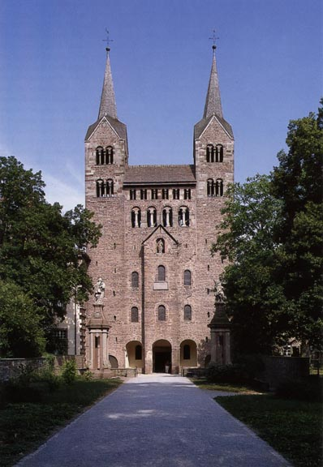
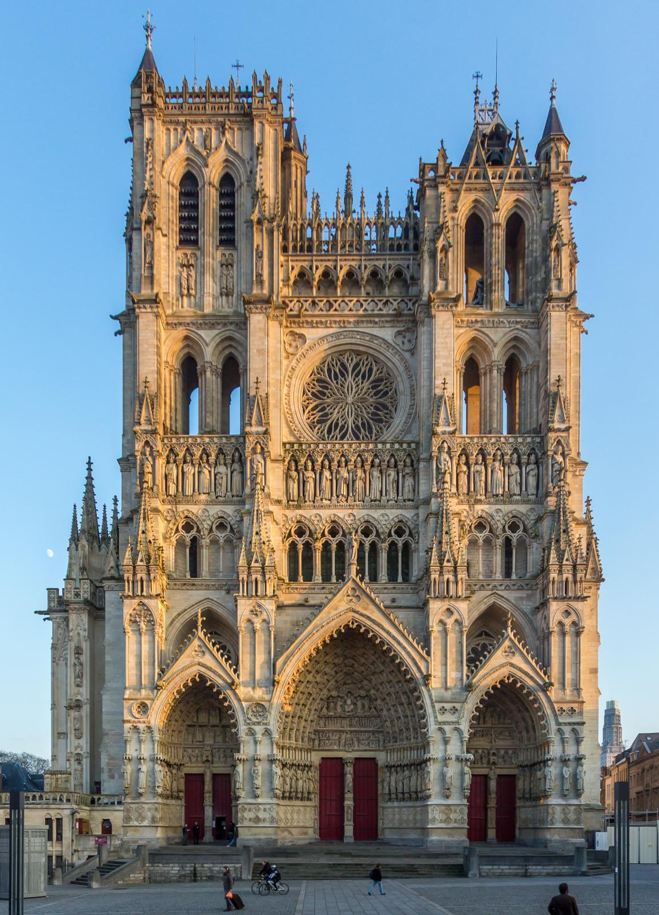
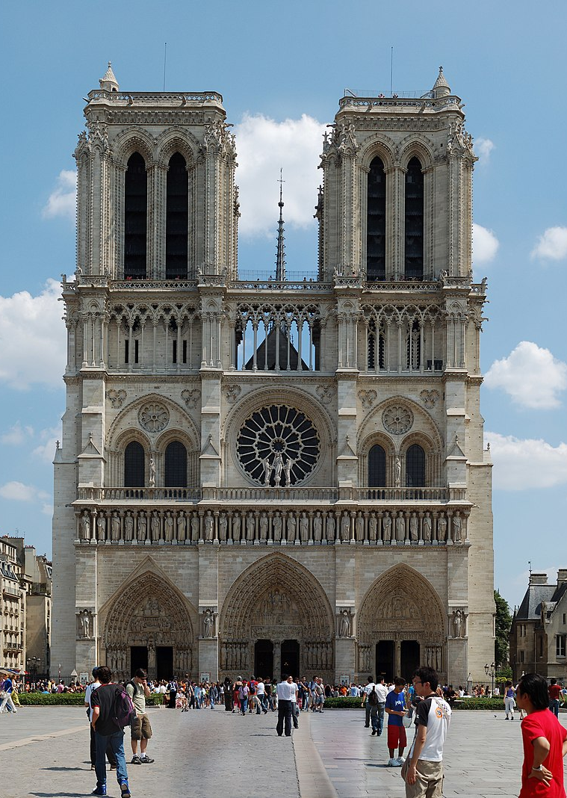
Example: Place these buildings in chronological order
Placing architectures in chronological/stylistic order
Requires the knowledge the basic characteristics of the main periods in the history of architecture
Requires the basic knowledge of the main characteristics of each of those periods
Involves the ability to distinguish the similar details in different images, or the different detail in similar architectures
A
B
C

Slide 16
Drawing & Representation
In accordance with the Ministerial Program for the secondary school, the Drawing & Representarion section of TOLD covers:
Basic knowledge of main representation-visualisation techniques-standards-styles
Ability to visualise a 3d form from a 2d drawing, and to abstract 3d objects into 2d drawings
Ability to recognise detail in complex compositions of forms
This section requires recognising the correct object from different angles, identifying mismatches in similar drawings, recognising objects drawn in different techniques.

Slide 17
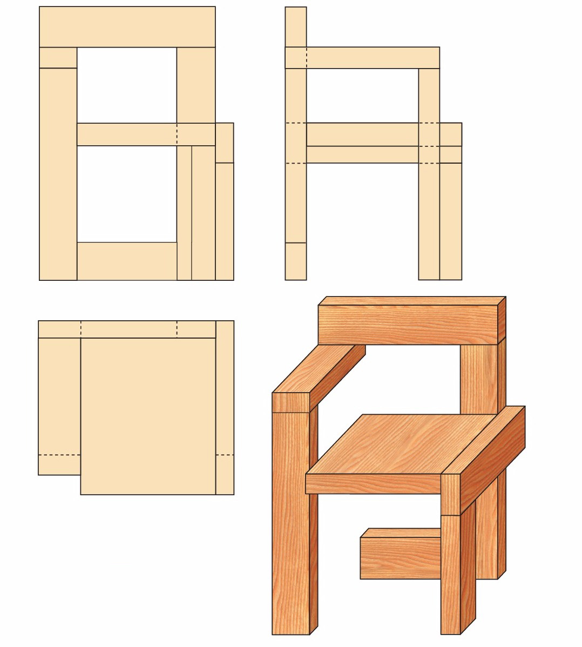
Example: Matching the correct sides of object drawn in axonometry and orthogonal projection
A B
TOP VIEW?
SIDE VIEW?
FRONT VIEW?
Identify the type and characteristics of different representation techniques
Identify same drawing drawn in different techniques
Ability to visualise small details in different views
Ability to abstract a 3d image into a 2d drawing
C
answer:
A - FRONT VIEW
B - SIDE VIEW
C - TOP VIEW

Slide 18
WHY CHOOSE OUR PREPARATION COURSE?
Many years of experience in preparing students for University in Italy (since 2014!).
+ 50% probability to pass the test.
Teachers specialized in the topics.
Student-friendly environment and free time activities.
The course will help you to better manage the time available, to gain more confidence with the questions and with useful strategies to pass the test.
Our academic advisors are always ready to support you.
Free access to our “Leonardo Online” platform.

Slide 19
Questions?
Feel free to ask any questions!

Slide 20
How to apply to our courses
THANK YOU FOR YOUR TIME!
E-mail: milan@scuolaleonardo.com
+39 0283241002
Fill our form online: https://www.scuolaleonardo.com/book-italian-language-course-in-italy.html

